Slide 1

Ride-Sharing Analytics Platform
Review – 3
Section No : 04
TEAM NO : 20
2420090101 – N DhanuSree
2420090032 - Y Viditha
2420030678 – G GopiKrishna
Under the guidance of
Dr. NALLA SIRISHA
Associate Professor
Department of Computer Science and Engineering
Koneru Lakshmaiah Education Foundation
(Deemed to be University estd. u/s. 3 of the UGC Act, 1956)
Off-Campus: Bachupally-Gandimaisamma Road, Bowrampet, Hyderabad, Telangana - 500 043.
Phone No: 7815926816, www.klh.edu.in

Slide 2
Table of Contents
Abstract
Introduction
Objectives
Literature Survey
System architecture

Slide 3

Abstract
The rapid growth of ride-sharing platforms like Uber has made data-driven decision-making essential for improving service efficiency and customer experience in urban transportation. This project, "Ride-Sharing Analytics Platform," proposes an Uber-like system that stores trip information, calculates peak traffic hours, tracks driver performance, and predicts future ride demand. The platform is built using Python for data processing, PostgreSQL for structured storage, Apache Kafka for real-time streaming, Apache Airflow for ETL pipeline orchestration, Docker for containerized deployment, and Power BI for interactive dashboard visualization. By automating data collection and transformation through scalable ETL pipelines, the system delivers actionable insights on demand patterns, traffic trends, and driver performance, supporting better fleet management and pricing decisions. Through this project, practical skills are gained in ETL pipeline development, database management, data warehousing, and dashboard design — key competencies for real-world data engineering roles.

Slide 4

Introduction
The emergence of ride-sharing platforms has significantly reshaped urban mobility, offering passengers a convenient, technology-driven alternative to traditional modes of transportation.
These platforms generate massive volumes of data daily — including trip requests, real-time driver locations, fare details, and user behavior patterns — making efficient data analysis critical for service improvement.
Despite this abundance of data, many platforms lack a structured analytical framework to convert raw data into actionable business insights.
Common operational challenges include inconsistent driver availability during peak hours, inefficient route allocation, and unpredictable fare surges, all of which affect customer satisfaction and platform reliability.
This project addresses these challenges by developing a Ride-Sharing Analytics Platform that processes trip data through automated pipelines to generate insights on demand, traffic, and driver performance.
The system leverages modern data engineering tools to deliver a scalable, real-time analytics solution that supports informed, data-driven decision-making

Slide 5
Objectives
To design and develop a data analytics platform that stores comprehensive ride-sharing trip information (pickup/drop location, fare, duration)
To calculate and visualize peak traffic hours across different zones for better fleet planning
To build a module for tracking and evaluating individual driver performance
To implement a predictive model that forecasts future ride demand using historical data
To build automated ETL pipelines using Apache Airflow for reliable, scheduled data processing
To enable real-time data ingestion using Apache Kafka for continuous trip event streaming
To containerize the entire application using Docker for consistent, scalable deployment
To present all insights through an interactive Power BI dashboard for data-driven decision-making

Slide 6
Literature Survey
S.No | Research paper | Author(s) | Link | Drawback
1. | Short-term prediction of demand for ride-hailing services: A deep learning approach (UberNet) | Long Chen et al. | https://arxiv.org/abs/2212.03956 | Trained on NYC-specific data; may not generalize well to other cities with different traffic patterns
2. | Analysis and prediction of New York City taxi and Uber demands | (NYC study, published in scielo.org.mx) | scielo.org.mx/scielo.php?script=sci_arttext&pid=S1665-64232023000500886 | Built around NYC's zip-code zones and weather data; not directly applicable to other cities
3. | Ride-hailing fares and demand interactions | (ScienceDirect, 2026) | https://sciencedirect.com/science/article/abs/pii/S0739885926000351 | Focuses only on Uber and Lyft in New York City over a short 15-day window, so findings may not hold for other markets or longer time periods.
4. | Predicting rideshare demand (Public Policy Analytics, Ch. 8) | Ken Steif | https://urbanspatial.github.io/PublicPolicyAnalytics | Notes that spatio-temporal forecasting remains an open research problem, and reactive routing approaches often arrive after a demand spike has already ended.
5. | Modeling and prediction of ride-sharing utilization dynamics | (Hindawi, Journal of Advanced Transportation) | https://hindawi.com/journals/jat/2019/6125798 | The prediction method is validated on a single dataset of NYC taxi trips from a specific month, limiting confidence in broader applicability.
6. | Real-time text analytics pipeline using open-source big data tools | Hassan Nazeer, Waheed Iqbal, Fawaz Bokhari, Faisal Bukhari, Shuja Ur Rehman Baig | https://arxiv.org/pdf/1712.04344 | Evaluated only on Twitter sentiment data at a relatively small scale (under half a million tweets), so scalability to much larger, continuous ride-sharing data streams is not proven.

Slide 7
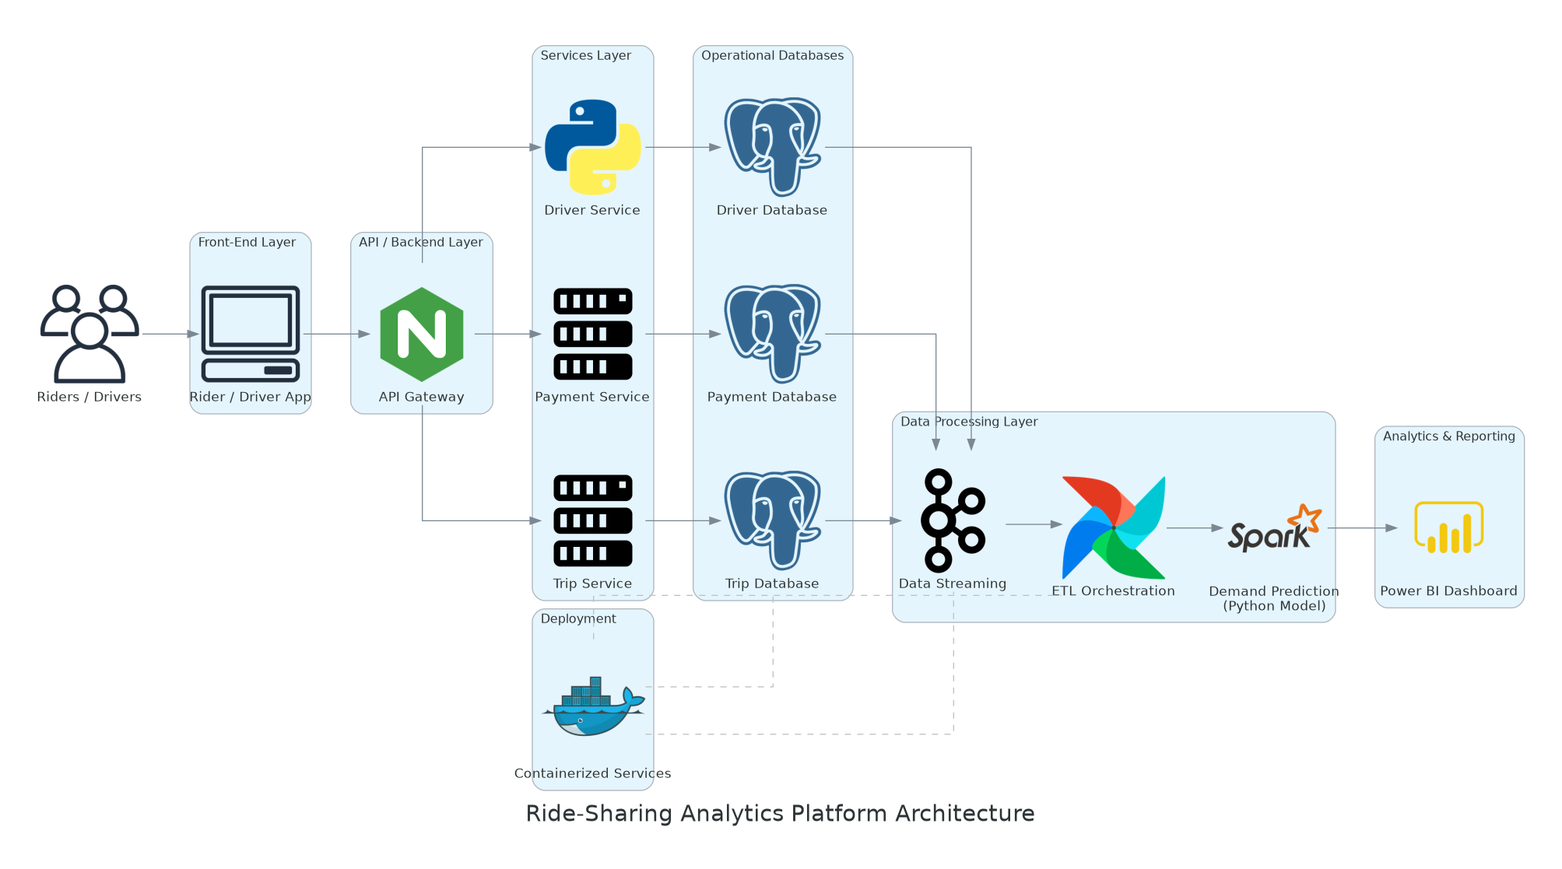
System Architecture

Slide 8
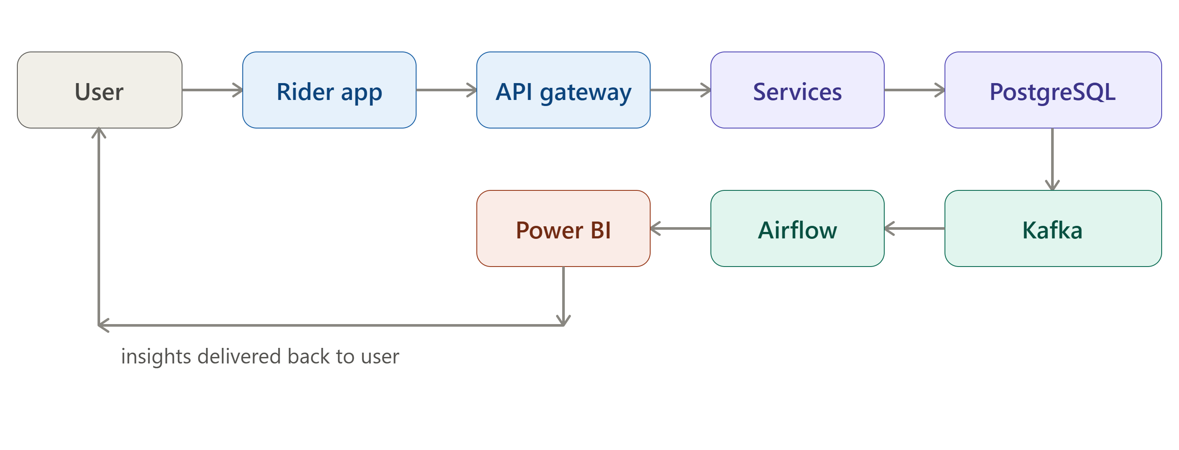
Methodology, System Design and Architecture
Methodology
Collect trip, driver, and payment data from the app
Stream real-time trip events using Kafka
Clean and transform data via automated Airflow pipelines
Analyze traffic, driver performance, and demand trends
Display insights on Power BI dashboards
System Design
Riders/drivers generate trip, driver, and payment events
API Gateway routes requests to backend services
Services store structured data in PostgreSQL
Pipeline streams and transforms data in real time
Analytics engine produces traffic and demand insights

Slide 9
Use of Modern Tools and Technologies
Technologies Used
Processing: Python – data processing and demand prediction logic
Storage: PostgreSQL – structured storage for trip, driver, and payment data
Streaming: Apache Kafka – real-time streaming of trip events
Automation: Apache Airflow – orchestration of automated ETL pipelines
Deployment: Docker – containerized deployment of backend services
Visualization: Power BI – interactive dashboards for insights
These tools are widely used in real-world data engineering roles at companies like Uber, Netflix, and Amazon — reflecting industry-standard practices rather than academic-only methods.
Benefits
Efficient, real-time data processing at scale.
Better analysis of traffic and demand patterns.
Supports accurate driver performance tracking.
Helps improve fleet management and decision-making.

Slide 10
Implementation, Coding Quality and Functionality
Implementation
Build ETL and streaming pipeline
Process trip, driver, and payment data
Analyze peak hours and driver performance
Predict demand using historical data
Display results on Power BI
Coding Quality
Modular Python code (separate extract/transform/load functions)
Clear variable/function naming
Data validation before storage
Independently testable components
Functionality → (insert a similar small flow image: Trip event → Kafka → Airflow → PostgreSQL → Analysis → Power BI, instead of the text sentence)
Real-time trip/driver data collection
Peak zone and hour detection
Driver performance tracking
Better fleet planning

